Slide 1
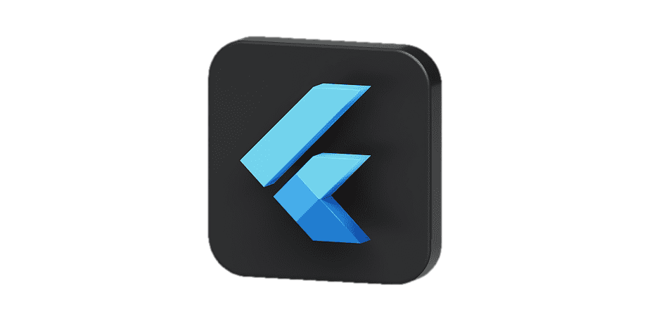
Dart & Flutter
Everything is a widget

Slide 2






Dart
Flutter Intro
Widgets
State Management

Slide 3
01

Slide 4
02

Slide 5
03

Slide 6
Intro To Flutter
02

Slide 7



Your phone is a sketch and flutter is the brush
Flutter

Slide 8
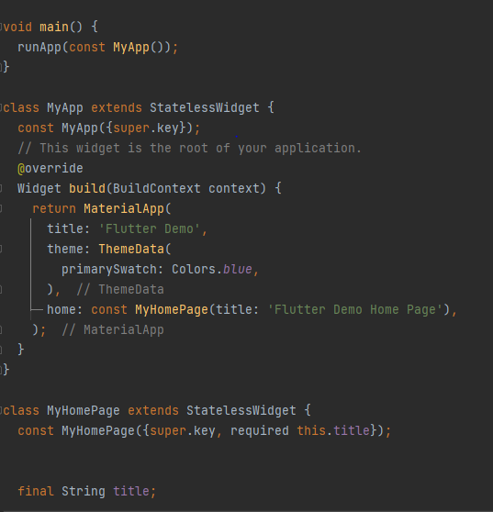



Slide 9
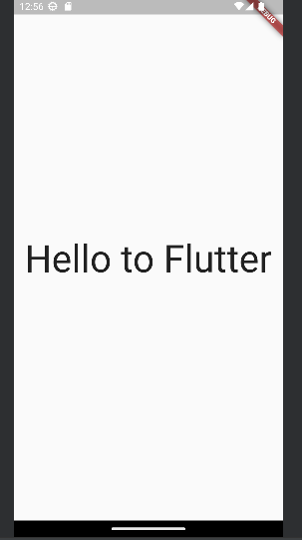

Slide 10
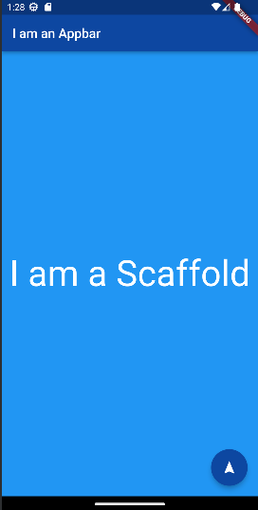
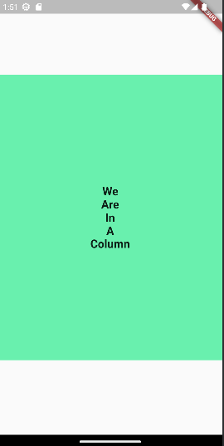
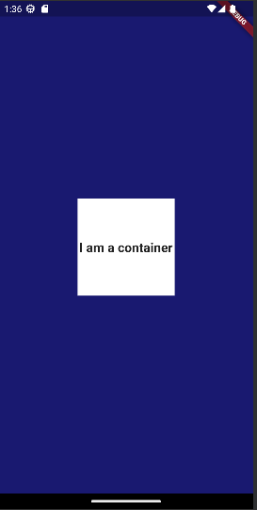
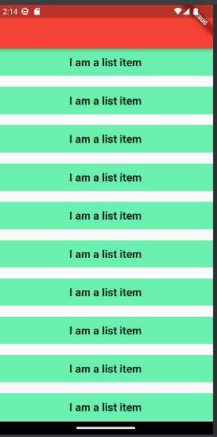
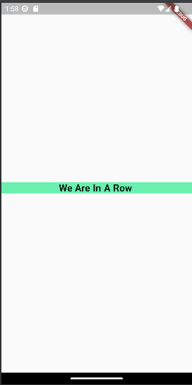
Scaffold
Row
Column
Container
List

Slide 11
Row
Column
Container
Scaffold
List

Slide 12

List
Row
Column
Container
Scaffold

Slide 13
Row
Scaffold
List
Column
Container

Slide 14
List
Row
Column
Container
Scaffold

Slide 15

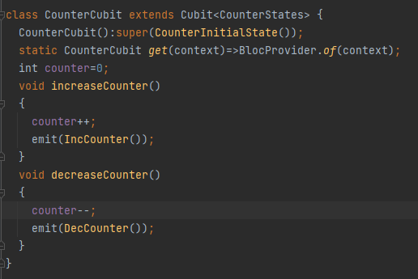
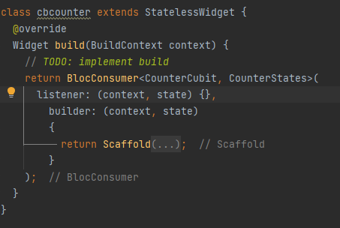
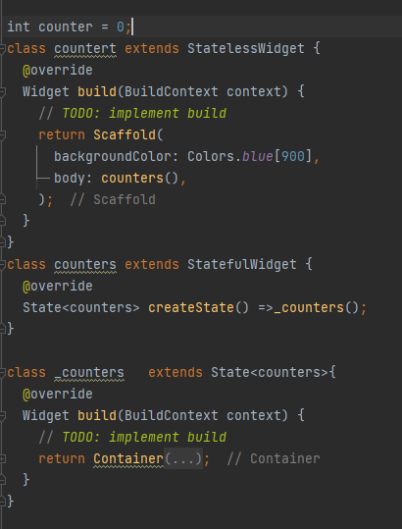
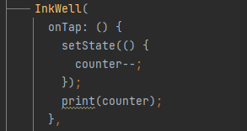
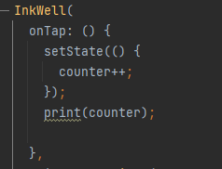
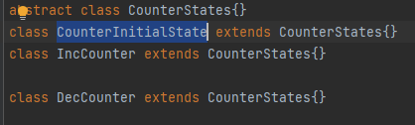
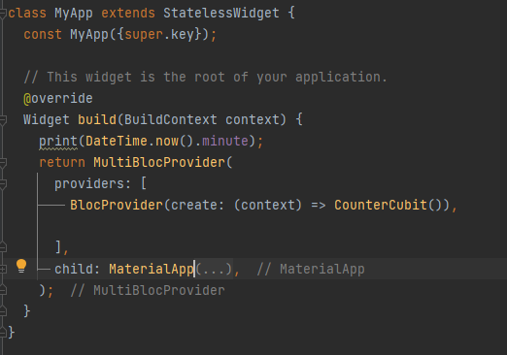
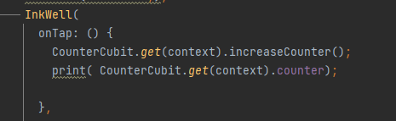
Stateful Widget
Bloc

Slide 16
Stateful Widget
Bloc

